Slide 1
Career and technical education: Career pathways
Presentation: New CTE Coordinators
Wednesday, September 3, 2014

Slide 2
Objectives:
Vision for the System
Performance Assessments
Free Dual Credits
Structure of the System
Programs of Study
Standards
Rigor and Relevance Framework

Slide 3
Vision for Career and Technical Education
College and Career Ready
Work Ready
Performance-Based Assessments
Written Test
Research Paper
Performance
Oral Presentation

Slide 4
Vision for Career and Technical Education
Free College Credits for High School Courses Taken in Career Pathway Programs of Study
University of Hawaii Community Colleges
University of Hawaii—West Oahu
Hawaii Pacific University
BOE Career and Technical Education Honors Designation

Slide 5
What is a Career pathway?
Way to organize courses into paths that lead to careers/occupations.
Pathways were developed in the 1990’s from the School-to-Work initiative.
There are six career pathways:
Arts and Communication
Business
Health Services
Industrial and Engineering Technology
Natural Resources
Public and Human Services

Slide 6
What is a Career Pathway Program of Study?
Programs of Study are embedded within each pathway.
At a minimum a program of study is a sequence of Career and Technical Education Courses and a related academic course (similar to Level I Japanese and Level 2 Japanese).
A Career and Technical Education Program of Study
Level 1—Pathway Core Course (ex. Business Core)
Level 2—Pathway Cluster Course (ex. Marketing)
Academic Course (ex. Economics)

Slide 7
Foundation of Program of Study Courses: Standards and Benchmarks
All Standards and Benchmarks are developed with input from business and industry representatives.
Standards/Benchmarks are written to ensure students have the knowledge and skills to be college and career ready.
Emphasis is on content and processes, including problem-solving, critical thinking, and communication.
Emphasis on Rigor and Relevance.

Slide 8
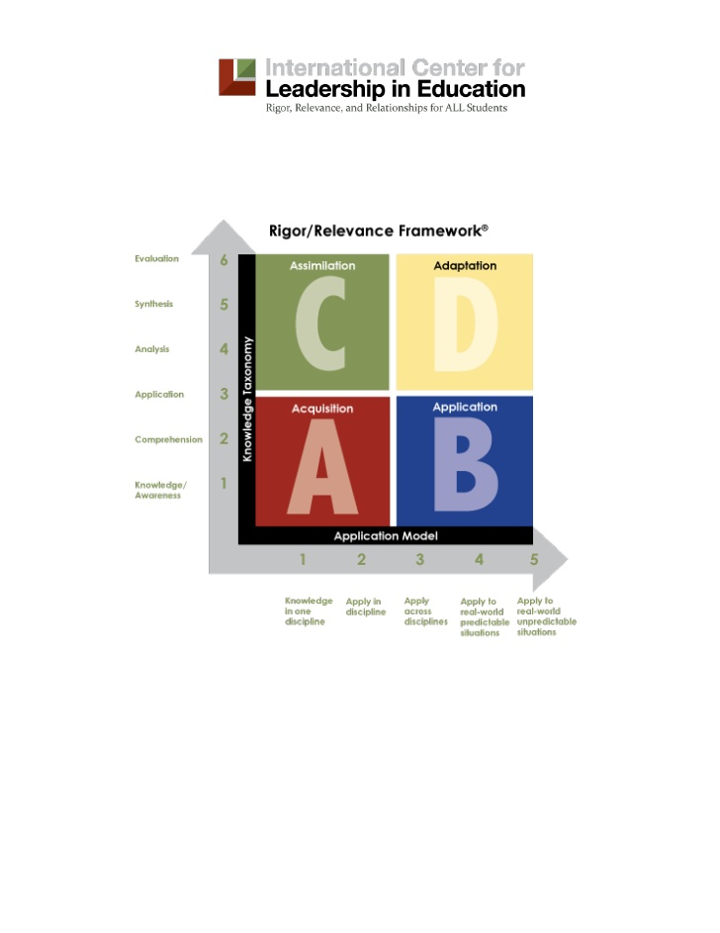
Rigor and Relevance

Slide 9
Questions?

